Slide 1



Implementing Transformer with Python & PyTorch
Quang Duong

Slide 2
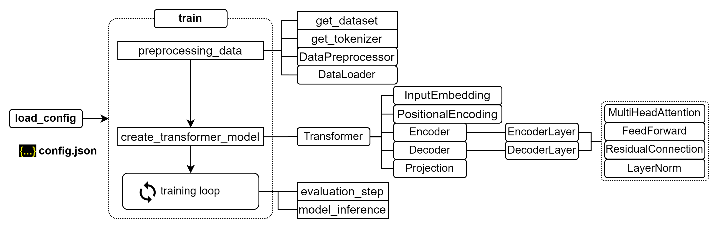
Training process for transformer

Slide 3
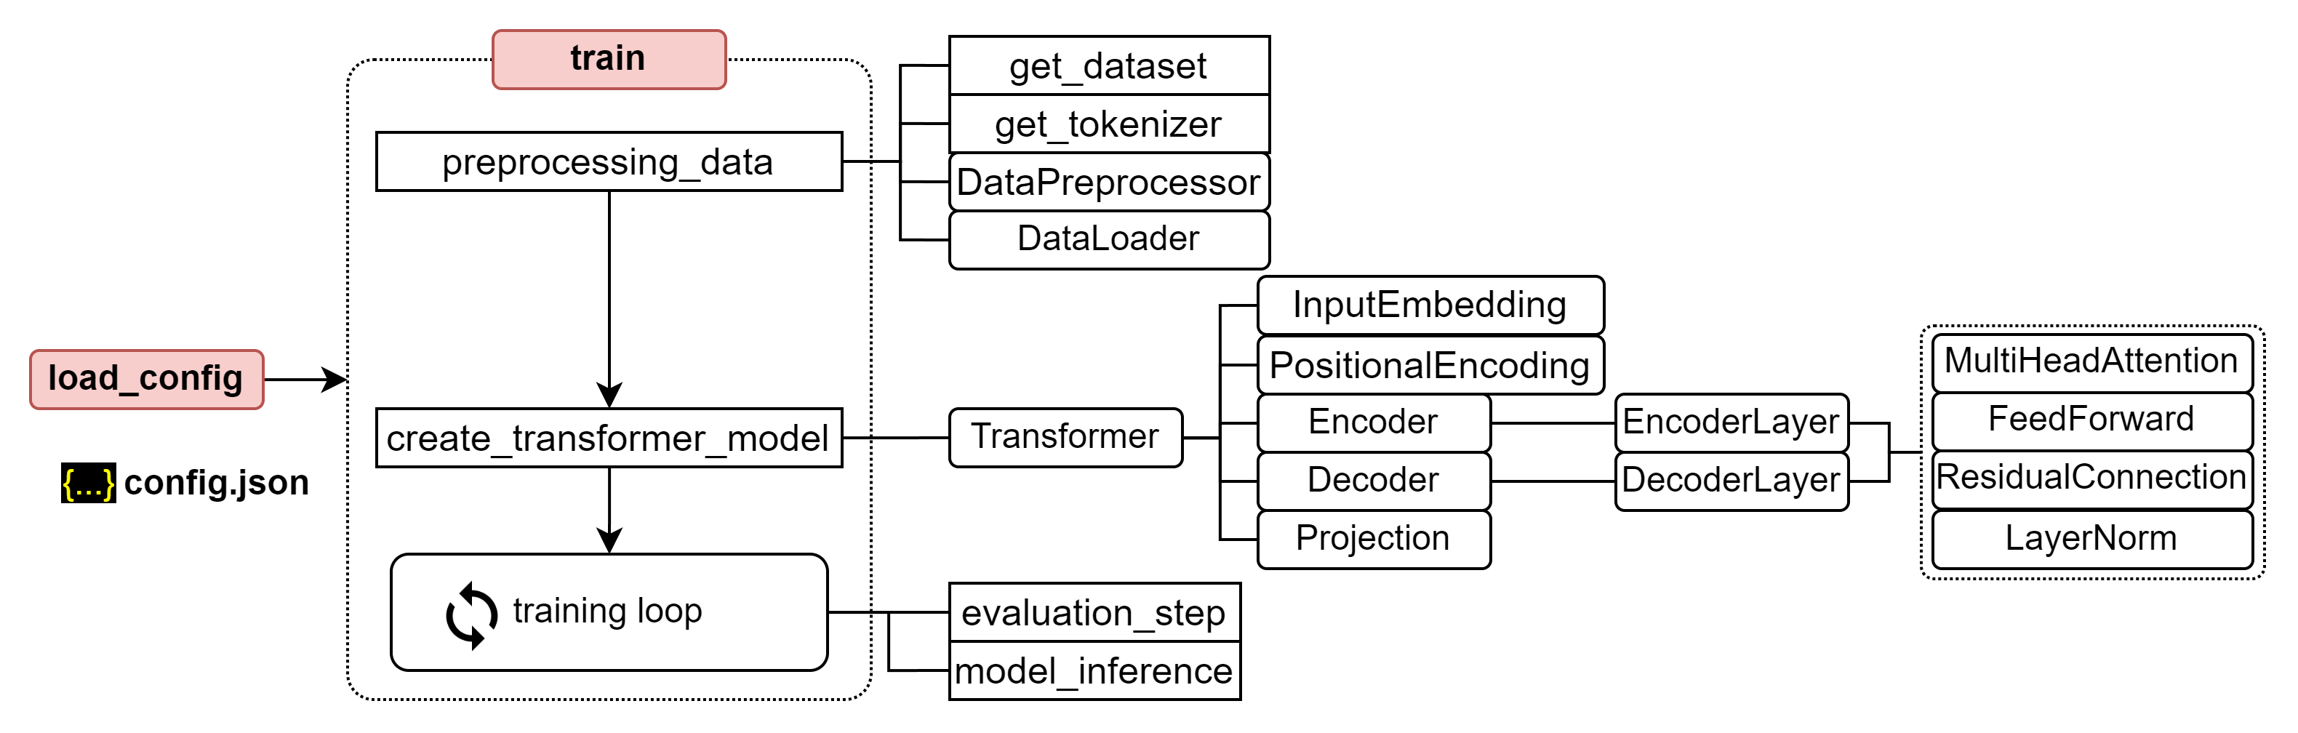
Training process for transformer

Slide 4
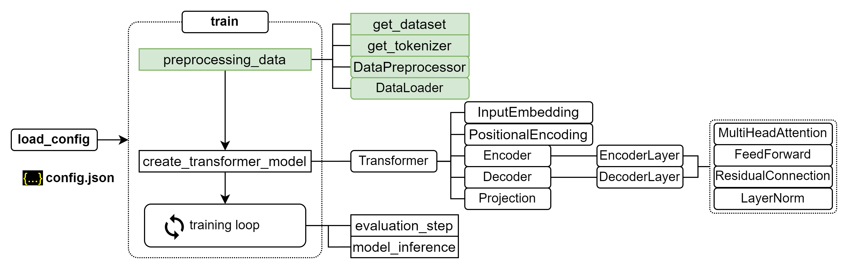
Training process for transformer

Slide 5
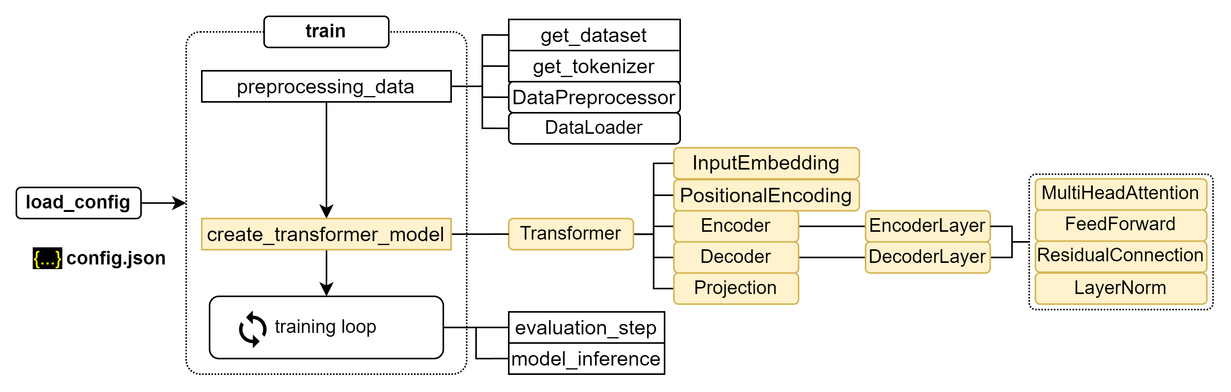
Training process for transformer

Slide 6
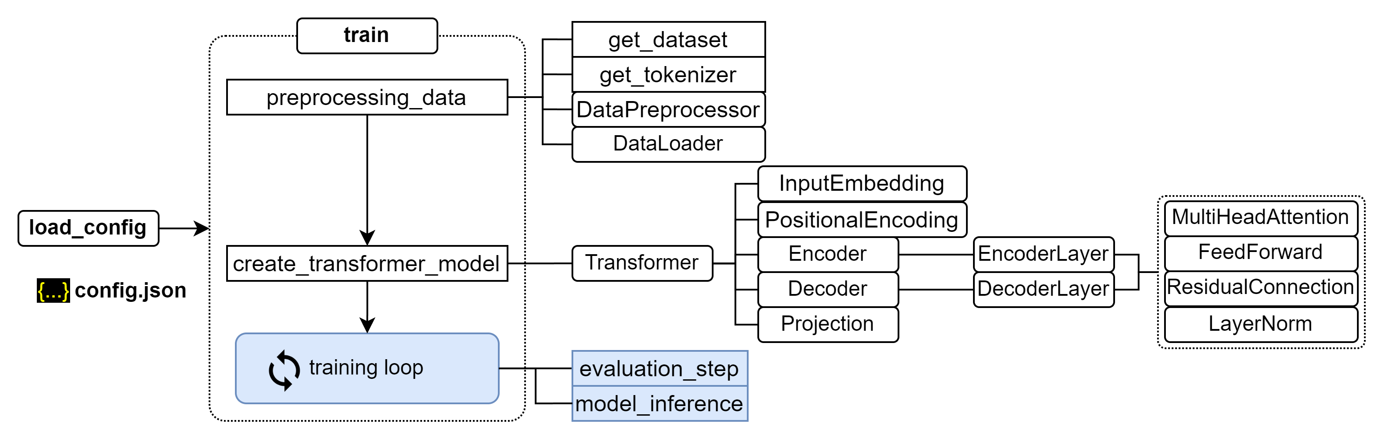
Training process for transformer

Slide 7
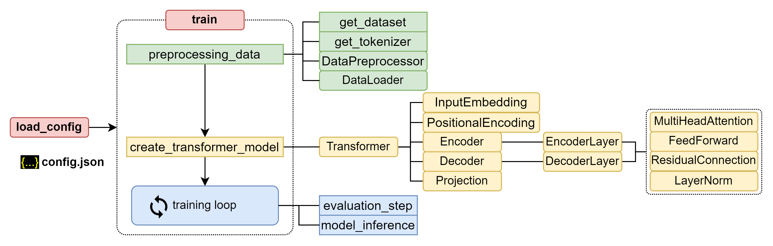
Training process for transformer

Slide 8
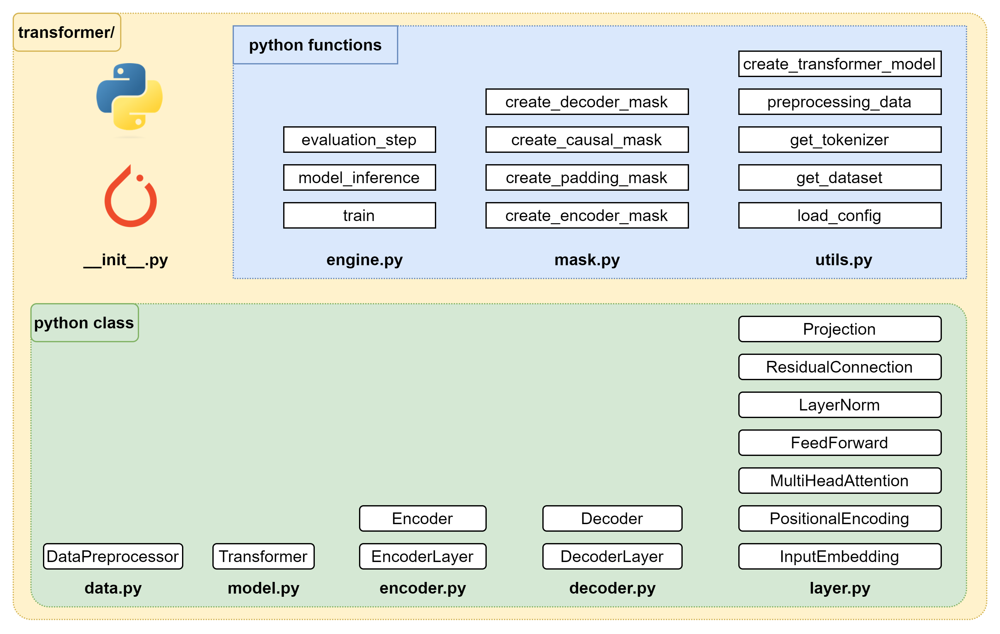
Building Transformer package

Slide 9
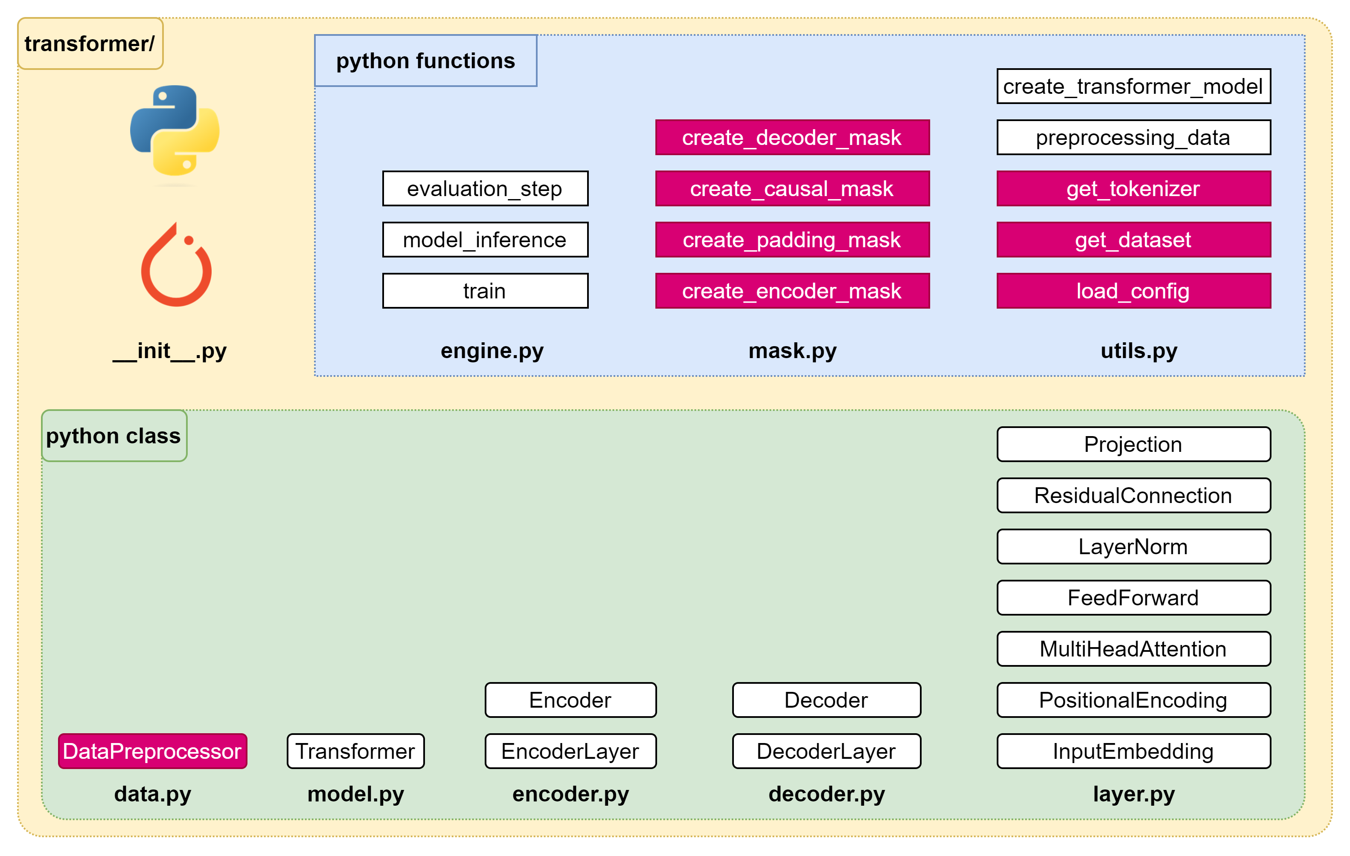
Implementation – Plan of attack (1/4)

Slide 10
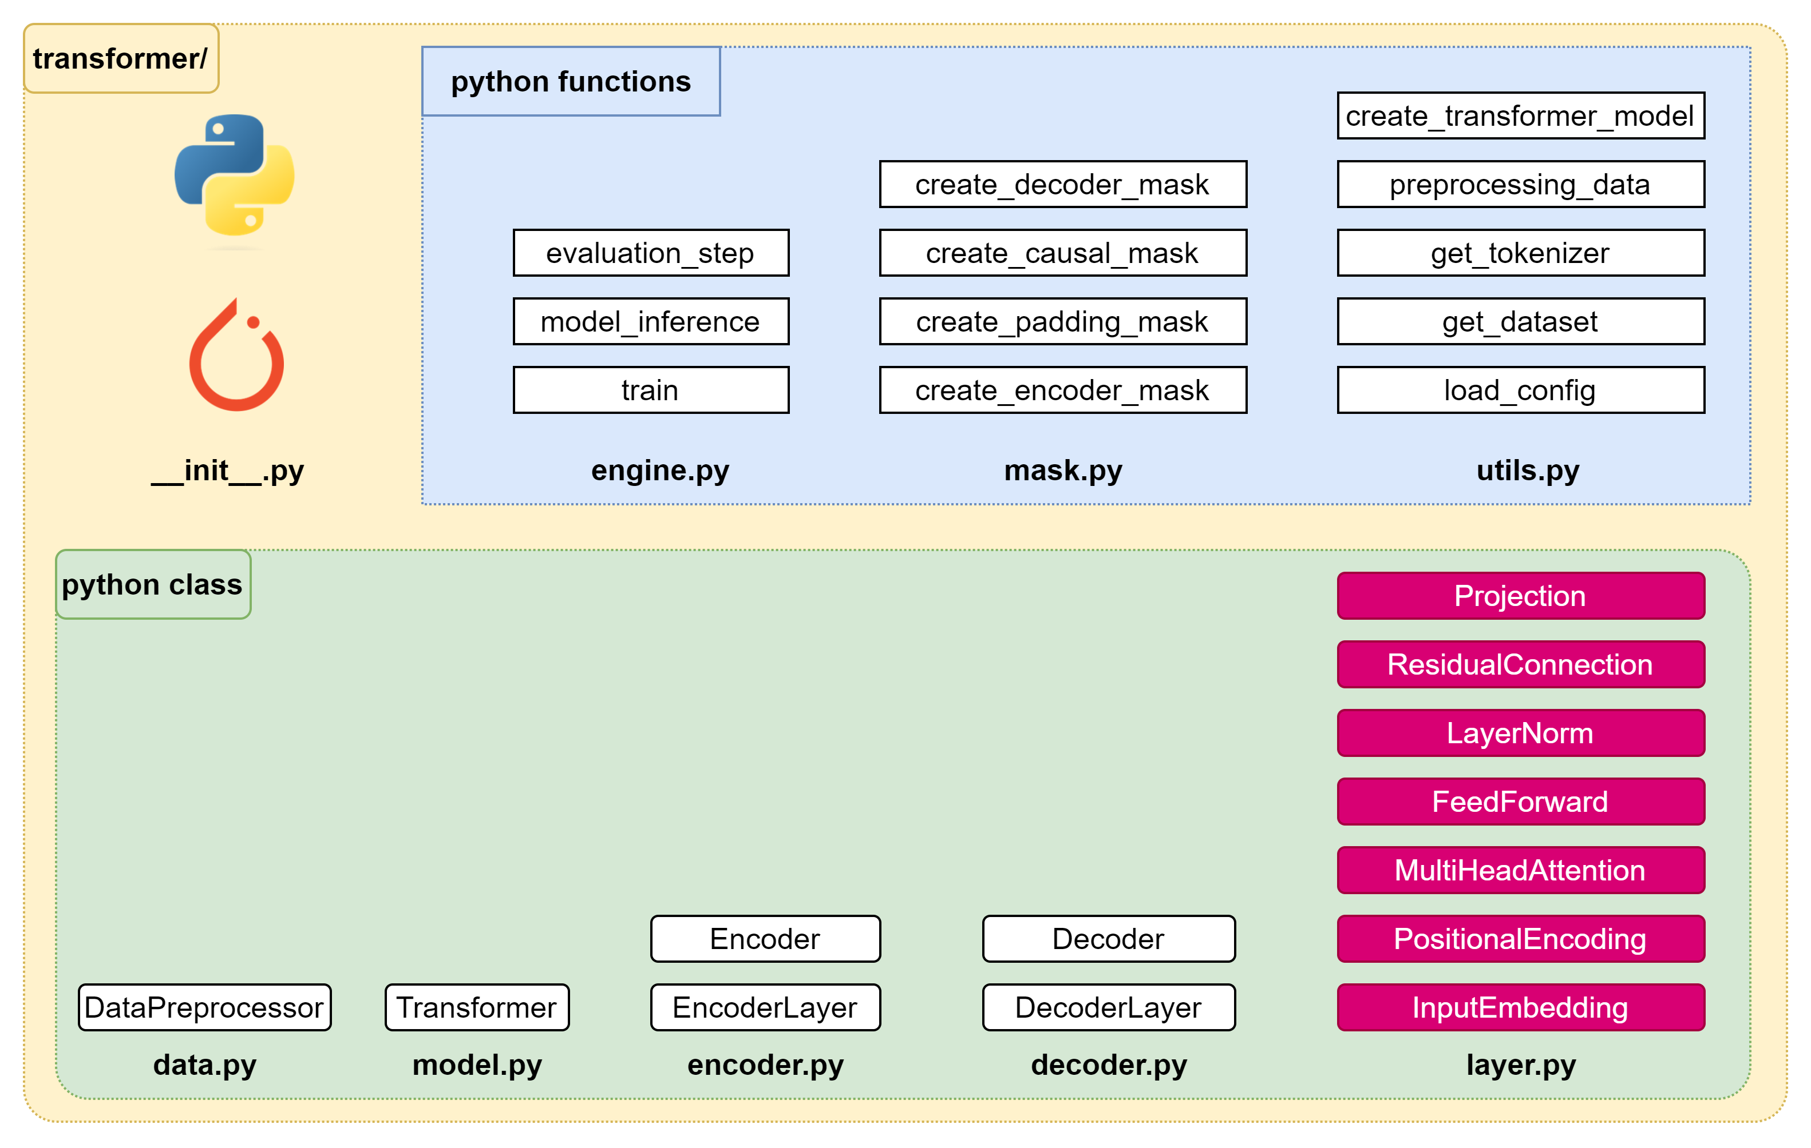
Implementation – Plan of attack (2/4)

Slide 11
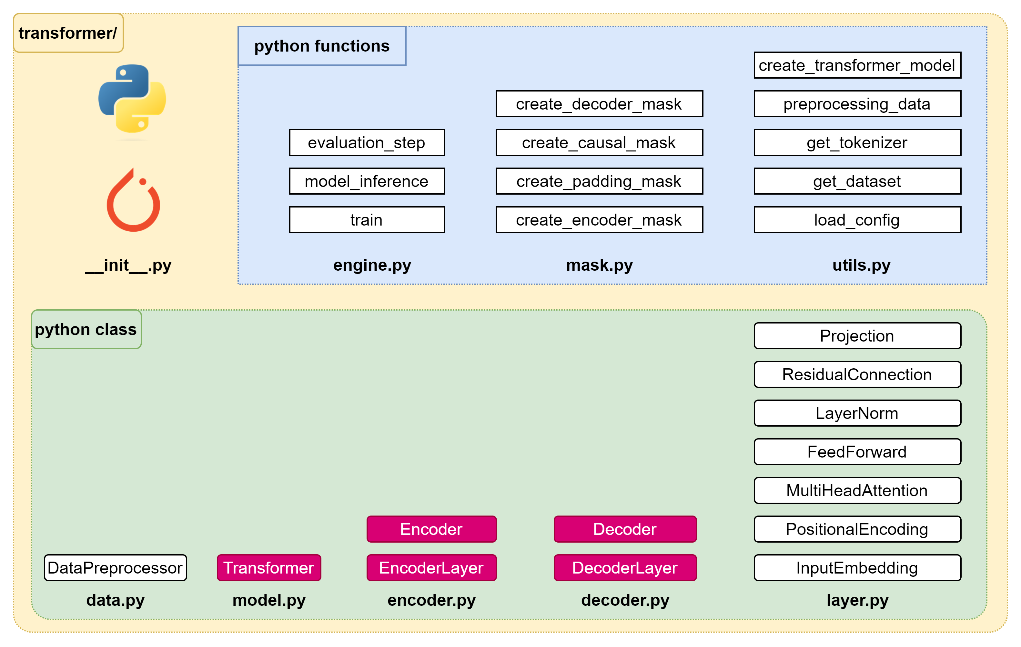
Implementation – Plan of attack (3/4)

Slide 12
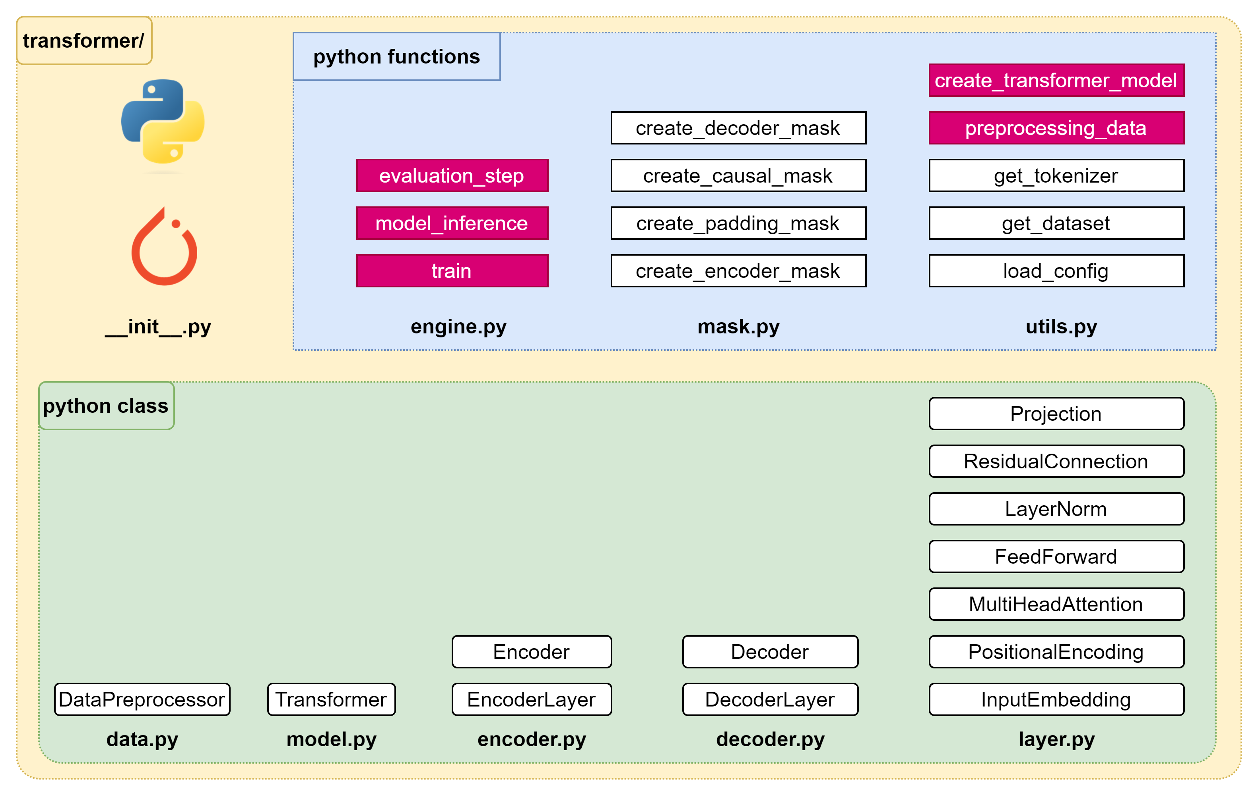
Implementation – Plan of attack (4/4)

Slide 14
Implementation – Plan of attack (1/4)

Slide 15

Data – Data Preprocessor

Slide 17
Implementation – Plan of attack (2/4)

Slide 19
Implementation – Plan of attack (3/4)

Slide 20

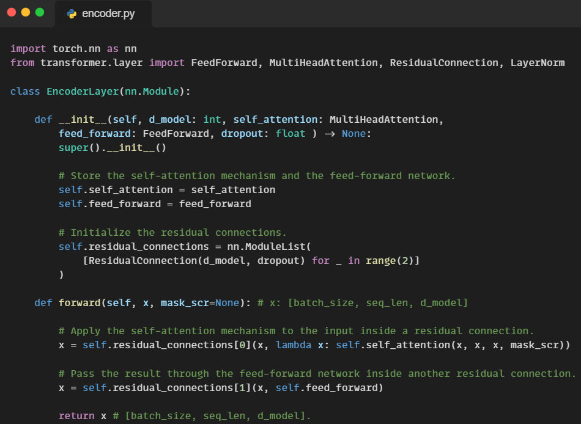
Encoder

Slide 21
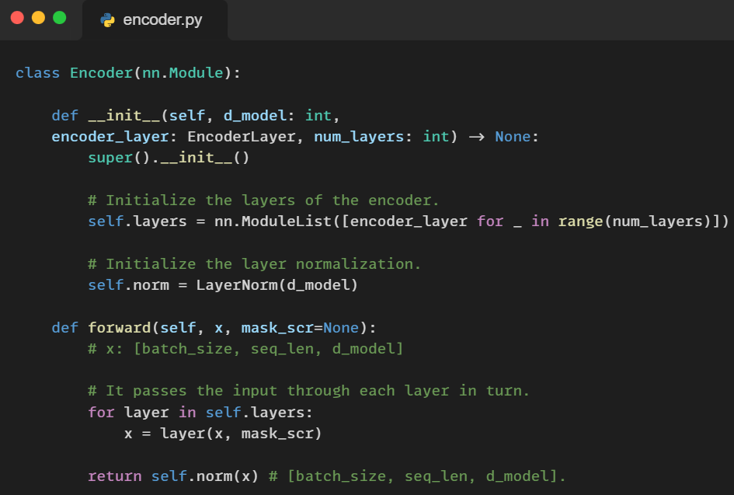
Encoder

Slide 22
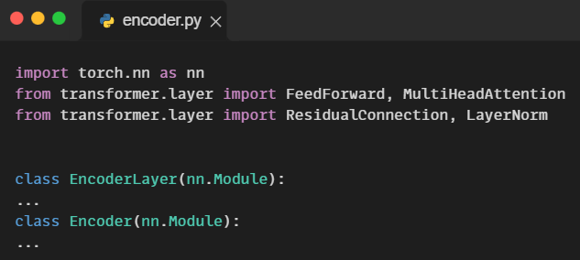
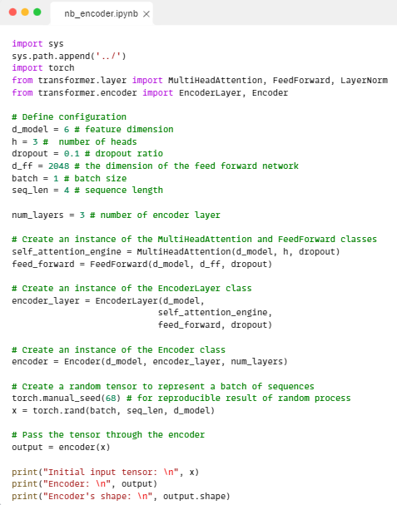
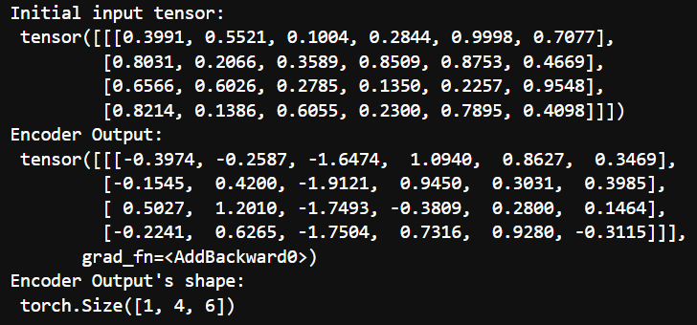
Encoder

Slide 23
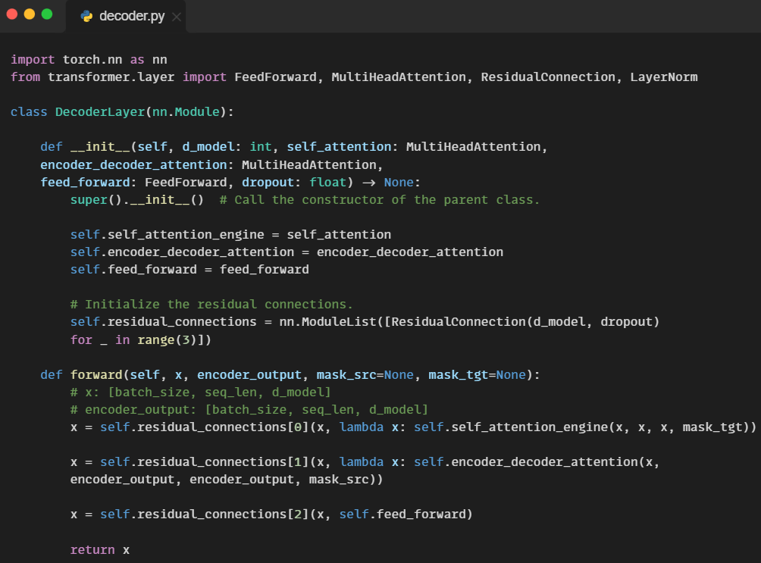
Decoder

Slide 24
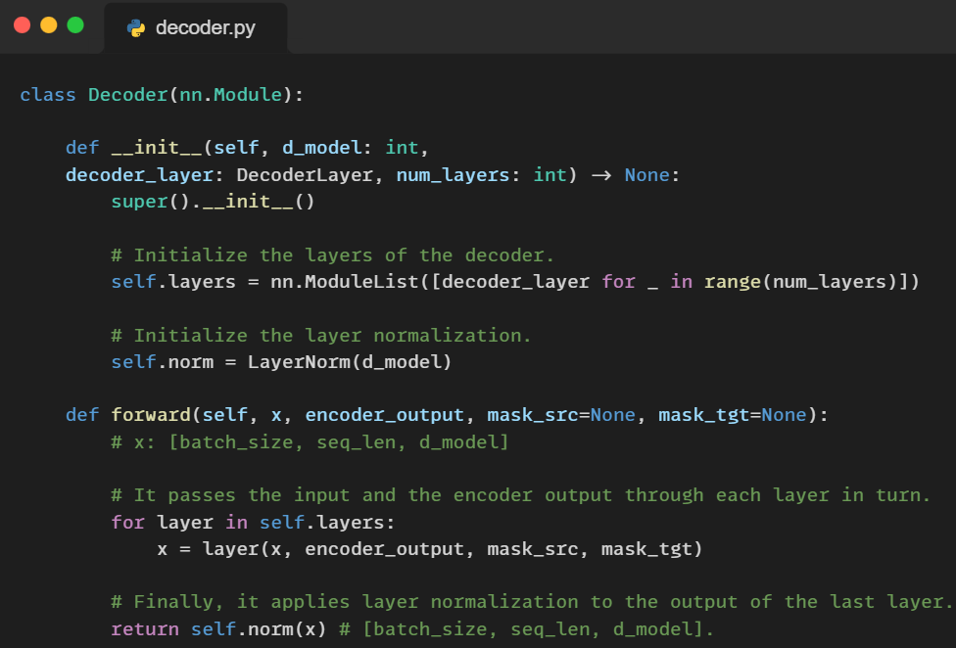
Decoder

Slide 25
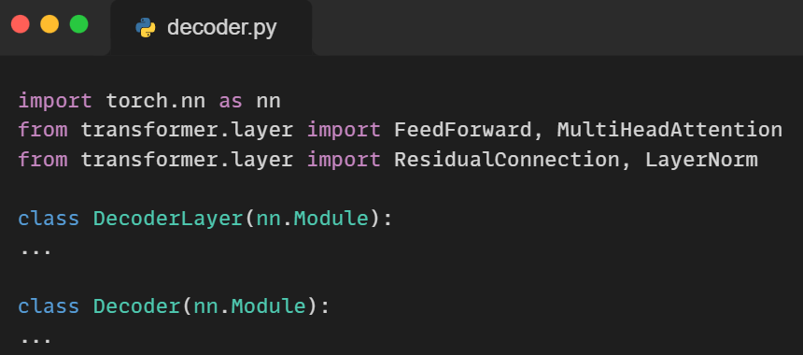
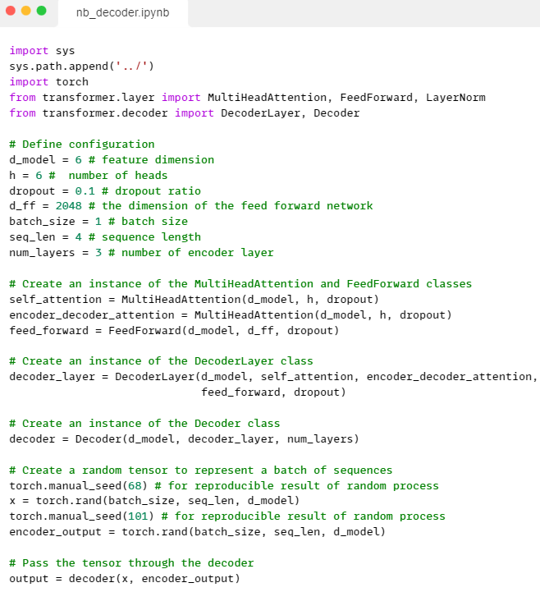
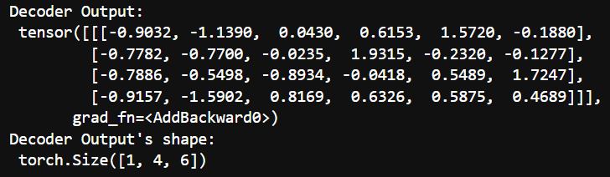
Decoder

Slide 26
Decoder

Slide 28
